Slide 1
Introduction to Machine Learning
Rex W. Douglass
Institute for Political Methodology (IPM) 2018

Slide 2
Who are you?
http://cpass.ucsd.edu/
Director of the Machine Learning for Social Science Lab (MSSL)
PhD Political Science Empirically, specialize in international security Methodologically, specialize in knowledge bases
www.rexdouglass.com
@RexDouglass
Automatically learning facts about people, places, things, and events from text or other sources.

Slide 3
What is this course?
6 hour introduction to machine learning lecture
3 Hours a day
1:15, 15 min break, 1:15, 15 min break
A github repository
https://github.com/CenterForPeaceAndSecurityStudies/IntroductiontoMachineLearning/
Plan of the Course
Day 1
1A Information Theory
1B Problems in Learning
Day 2
2A Solutions for learning in Supervised Settings
2B Solutions for learning in Unsupervised Settings

Slide 4
Note on Technology
Our current stack at the Machine Learning for Social Science Lab (MSSL)
R and Python
Spark for Database
Github for version control
R Notebooks and markdown for documentation
Keras/Tensorflow for deep learning
Ubuntu for OS and command line tools
R-notebook Provides Reading and Code Examples

Slide 5
What is Machine Learning?
Machine Learning is the
applied discipline of
inferring
useful functions
that reliably extract
information
from messages

Slide 6
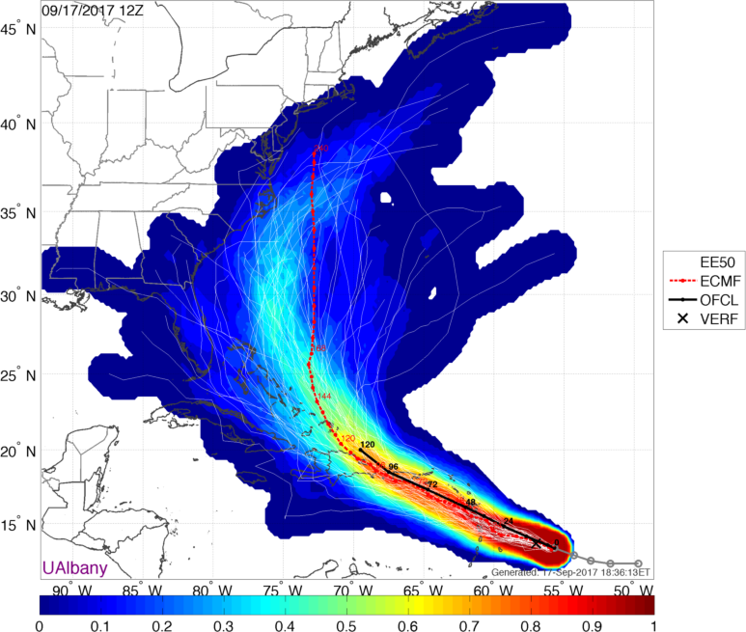
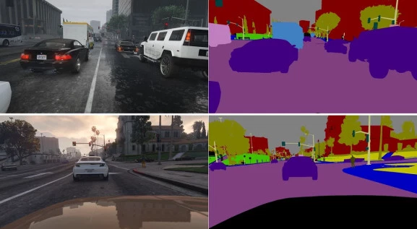

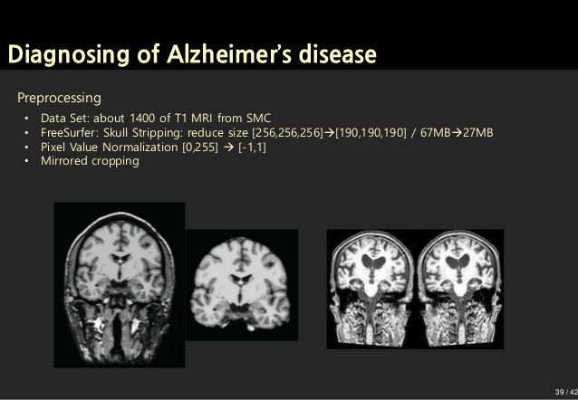
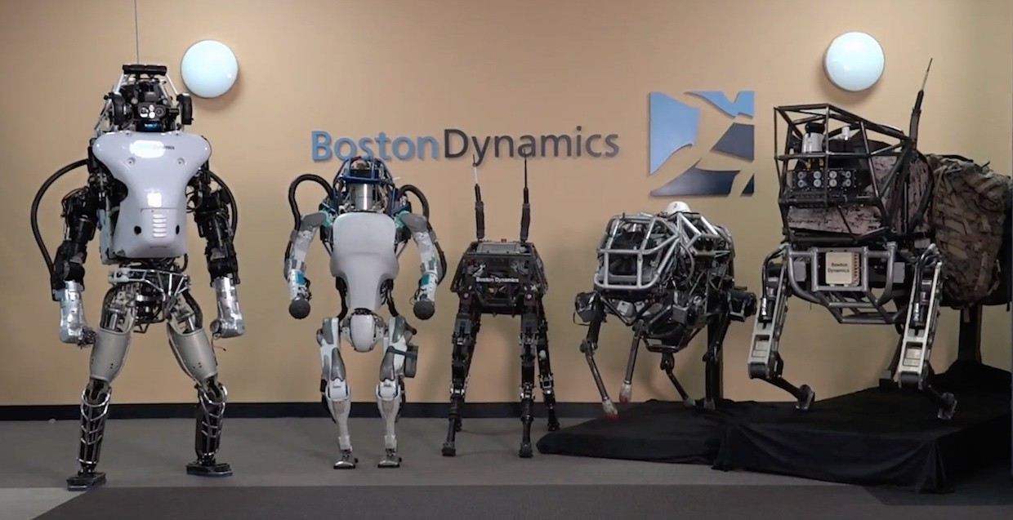
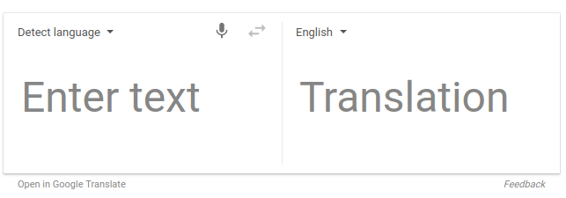
Why? (1/)

Slide 7
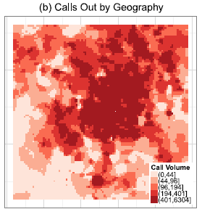
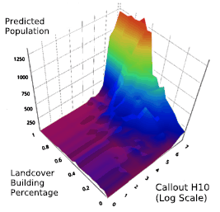
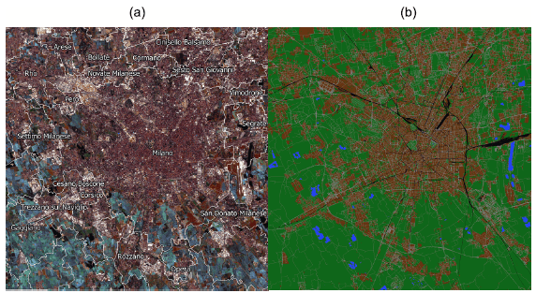
Why? (2/) Measure Hard to Measure Things
Real Time Population Census (Douglass et al. 2015)
Measure:
Population at the 55kmx55km box
Using:
Cell phone call records
Openstreetmap Land Cover
Satellite Imagery

Slide 8
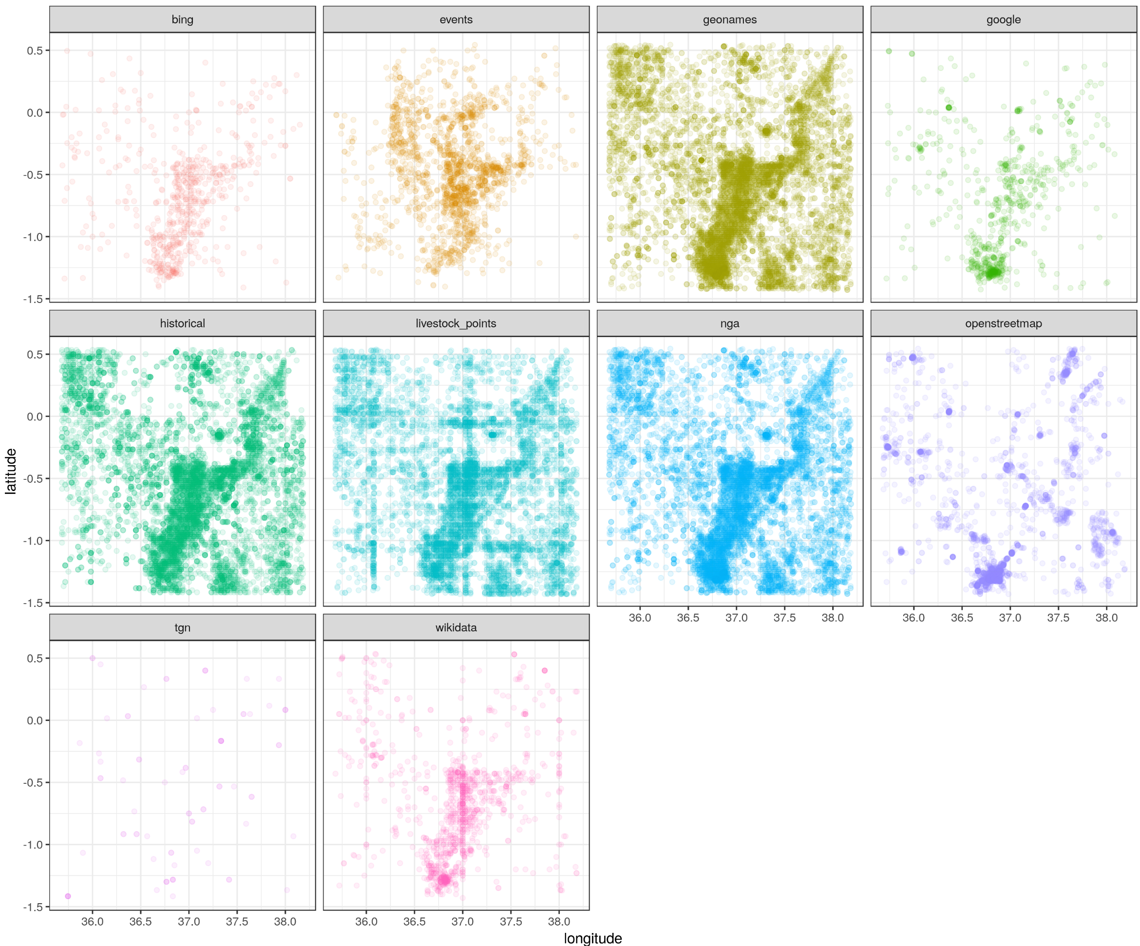
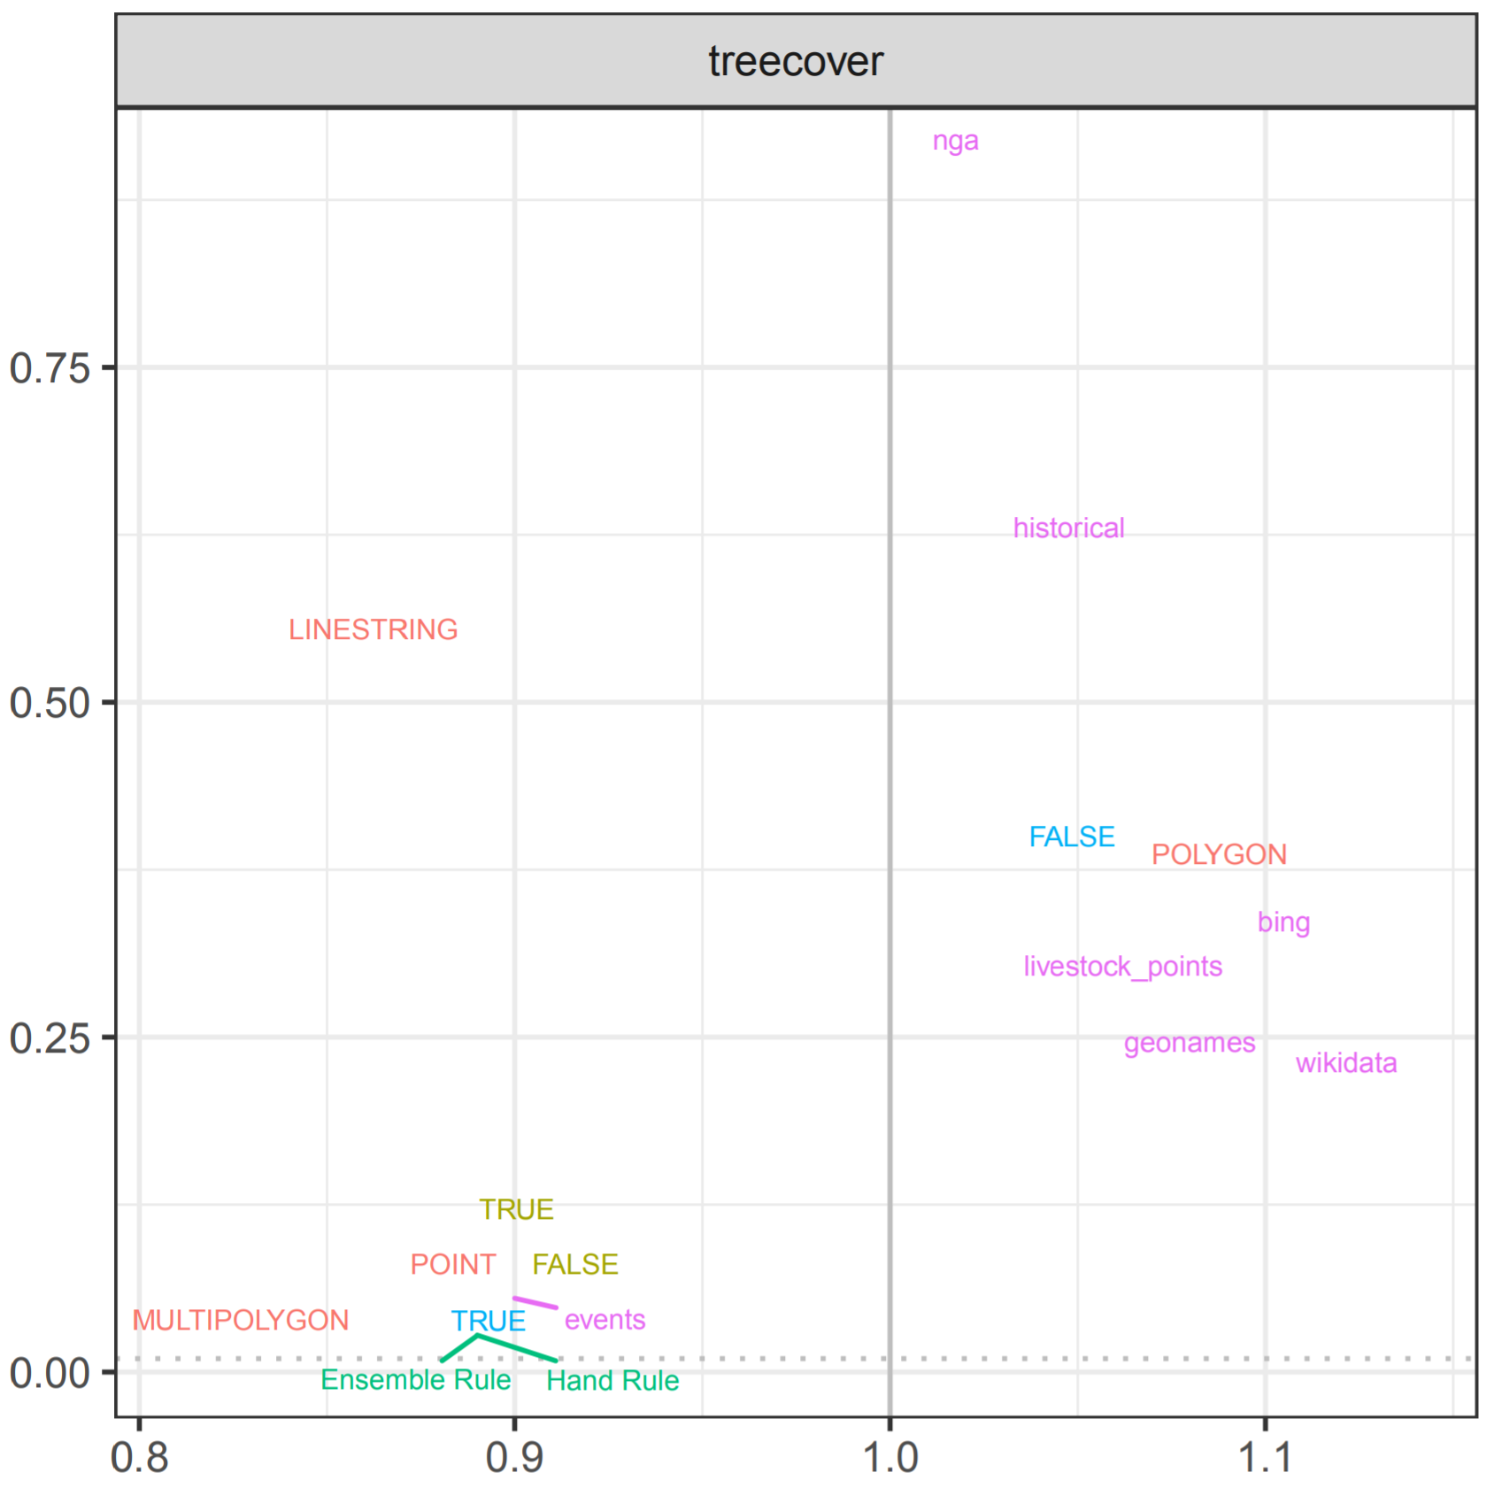
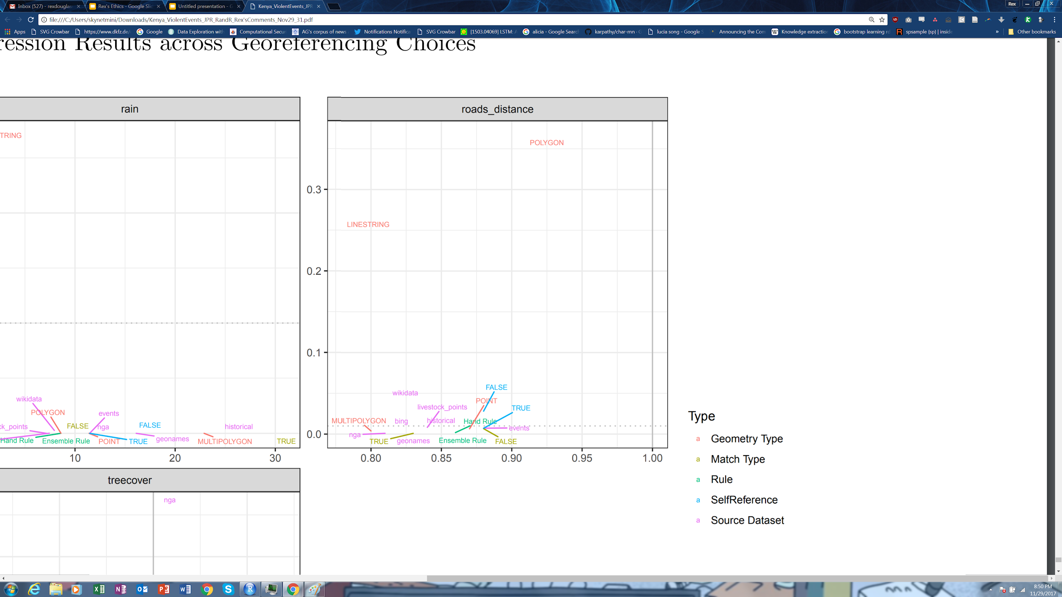
Why? (3/) Discover Problems in Existing Data
Civil War events in the Mau Mau Rebellion in Kenya (Douglass and Harkness 2018)
Georeferencing is how you assign events to specific locations on earth
Different (arbitrarily chosen) methods give different locations
Show that regression estimates flip sign and significance based on choice
P-Value
Effect Size and Direction

Slide 9
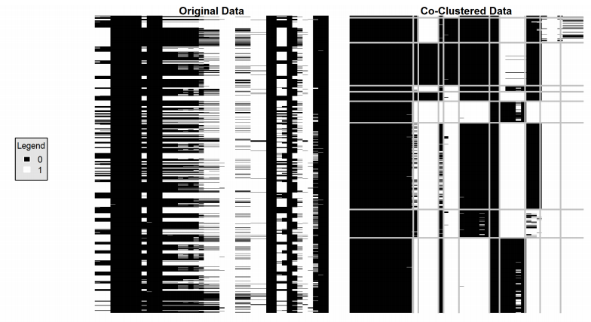
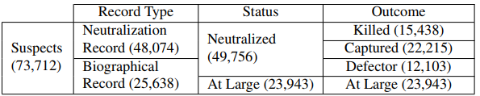
Why? (4/) Discover Problems in Existing Data
Targeted Assassinations in the Vietnam War (Douglass 2016)
Kalyvas and Kocher (2007) find that more important suspects actually more likely to get away
Unsupervised clustering show that’s entirely an artifact of the 1970s database. Two types of records were mixed together and the codebook is wrong.

Slide 10
Machine Learning is Not (1/): Statistics
We will not assume a true model
We will be more interested in predictive accuracy than parameters of any particular model
We will have more algorithms than proven mathematical results and guarantees
Tradeoff between ‘tends to work in practice’ and ‘guaranteed to always work’

Slide 11
Machine Learning is Not (2/): Causal Inference
Neyman–Rubin causal model
Causality is the difference between the observed reality and the counterfactual of what would have happened otherwise if not for X
Fundamental problem of causal inference
Never get to observe both reality where X happened and the alternate reality where it didn’t
Machine learning does not get you out of that problem
Still need experiments, luck, and clever tricks

Slide 12
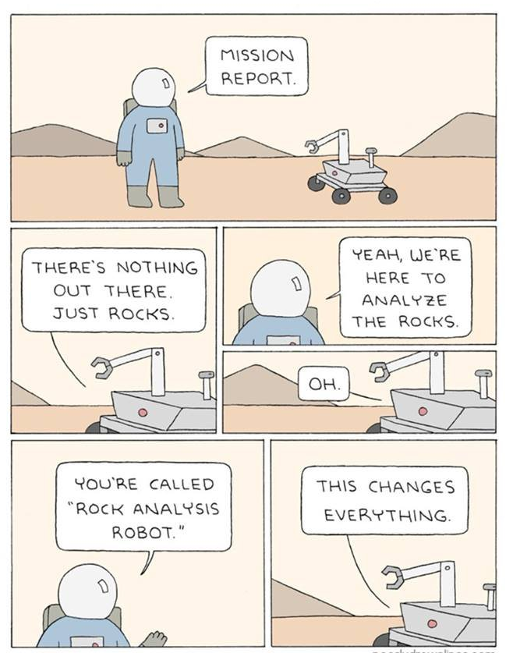

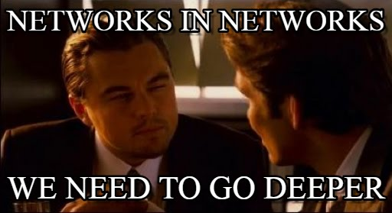
Machine Learning is Not (3/): <Insert Sexy Technology Here>
90% of your job will be data cleaning and documentation
9% will be trying simple off the shelf tools and tuning them
1% will be implementing novel architectures to squeeze out more accuracy

Slide 13
Outline for Lecture 1a
Information Source
Entropy
Evaluating Predictions
Binary
Multi-class
Real Valued
Transmission Functions
Receiver Functions

Slide 14
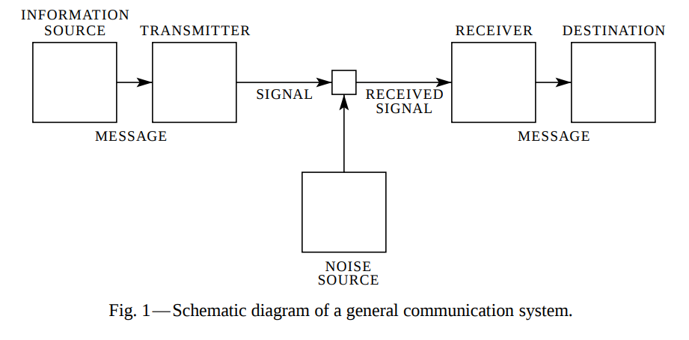


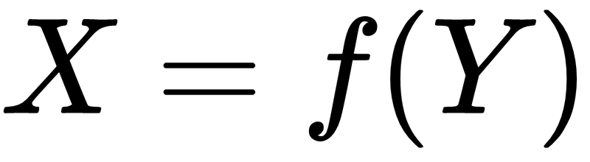
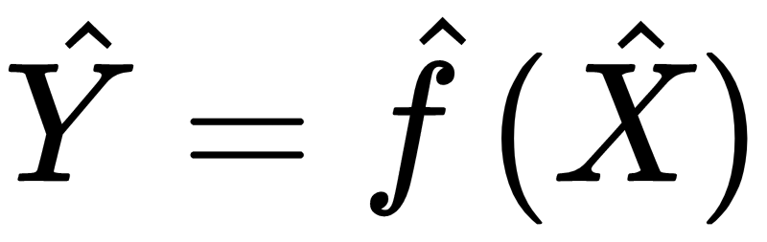
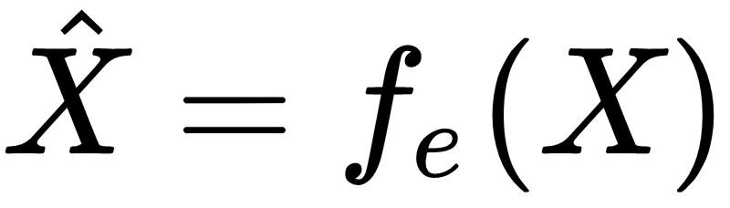
Shannon-Weaver Model of Communication (1/)
A message is
a state of an
information source
communicated to a
destination
(SHANNON 1948)

Slide 15
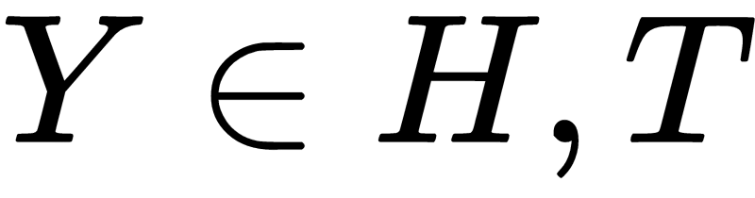
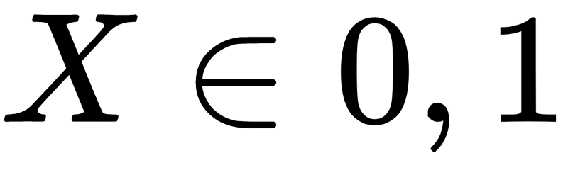

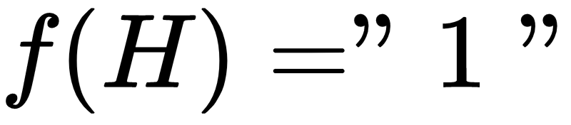
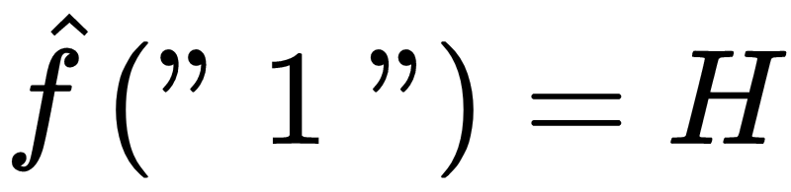
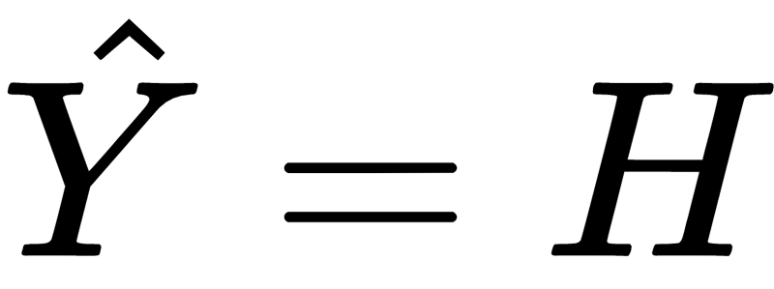
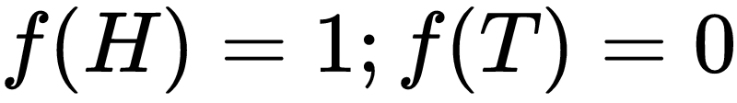
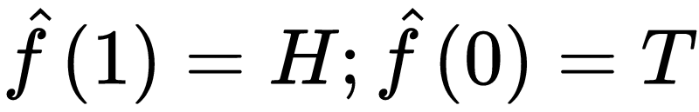
Shannon-Weaver (2/): Coin Toss
None

Slide 16
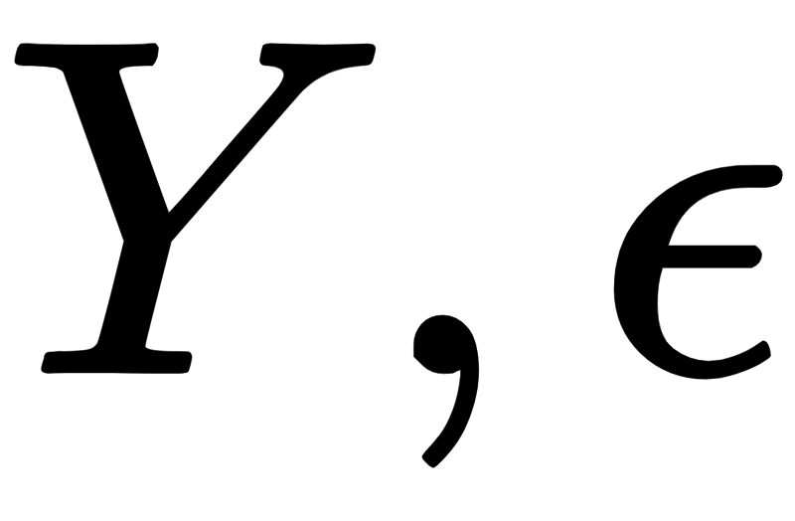
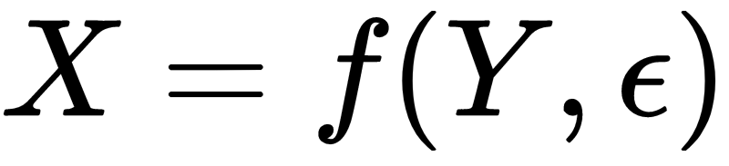
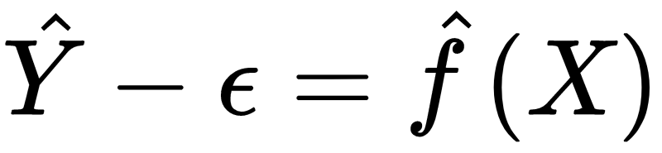
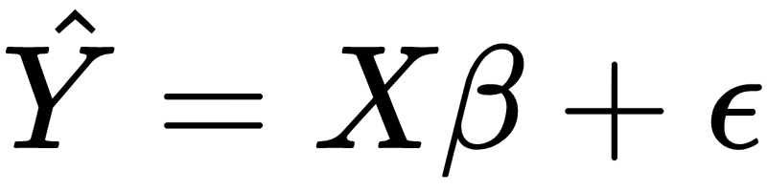
Shannon-Weaver (3/): Ordinary Least Squares
None = “X’s are fixed”
(SHANNON 1948)

Slide 17

Shannon–Weaver (4/)
-A random variable
-A coin flip
-A physical process
-Reality/God
-Encoder
-Encrypter
-A function
-Microphone
-Physical effect
-Decoder
-Decrypter
-A function
-A speaker
-Statistical model
-Line noise
-Measurement error
-Censorship
-Unmeasured covariates
(SHANNON 1948)

Slide 18


What is an information source? (1/)
An information source is something over which there can be uncertainty
A variable
Temperature outside right now
A random variable
A coin toss
Excludes constants
C=1
An (unfair) two headed coin toss (always heads)
It has a unique state among all the possible states it can take
Can be combination of multiples sources
E.g. OLS assumes both a Y and an epsilon is drawn for each observation

Slide 19
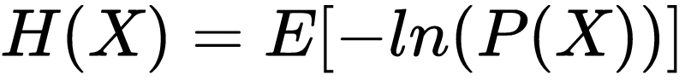
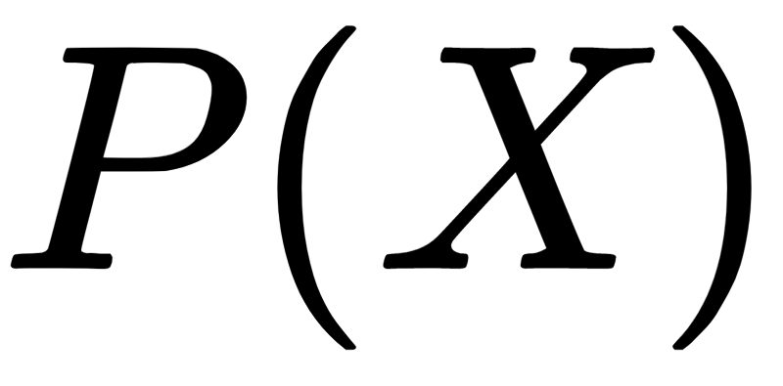
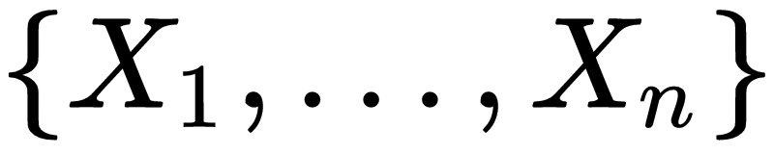
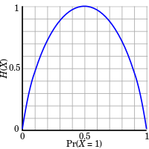
What is uncertainty?
Entropy (the amount of disorder/how easy it is to guess/how surprising)
Formalized as Entropy (Η)
For a random variable X with probability mass function
For a discrete random variable X with possible values
Picking base 2 for the log has a nice binary interpretation, number of bits
Fair coin toss, 1 bit of entropy
Unfair coin toss, [0,1) bits
Less surprise if more likely to be heads. No surprise at all if always heads.

Slide 20
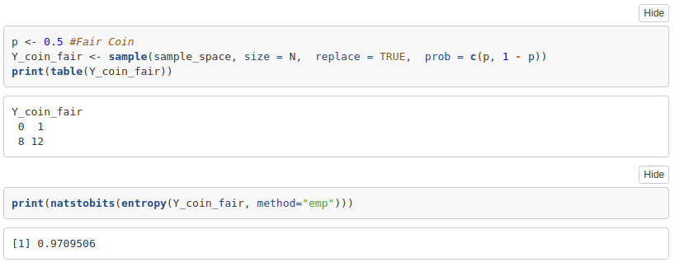
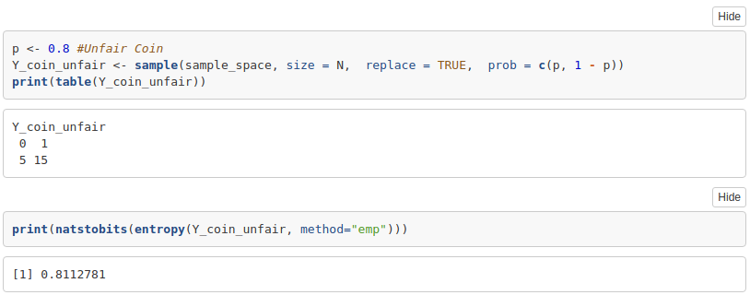
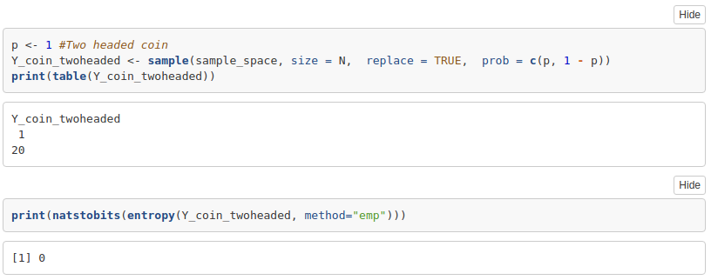
Entropy Calculations

Slide 21
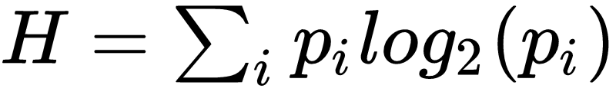
Example: A Zero Information Source
Student A - Flip a two headed (unfair) coin
Student A - Guess the outcome of the coin toss
Student A - Write down {‘H’,’T’} on a note for your guess of the state
Student A - Read your note. Were you right? How surprised are you by the result? (That surprise is the information.)
Formally
Message Space S = {H,T}
X is a deterministic constant
Entropy (measure of surprise) defined as
No surprise, no information!

Slide 22
Selecting on the Dependent Variable
In research design we insist that you not ‘select on the dependent variable’
Not always followed
(Pape 2003) ‘Logic of Suicide Terrorism’ APSR argues factors like military occupations increase the likelihood of suicide terrorism
Dataset only includes examples of suicide terrorism, never examples of terrorist campaigns that don’t use the tactic (Ashworth et al. 2008)
How much information was available in his dependent variable?
Only one state - Suicide Terrorism Used - Yes (p=1.0)
Looking at one of his observations, the entropy of his dependent variable
No information measured because no uncertainty in the outcome
Suicide Terrorism? | ...
1 | ...
1 | ...
1 | ...
1 | ...
1 | ...
1 | ...
...

Slide 23
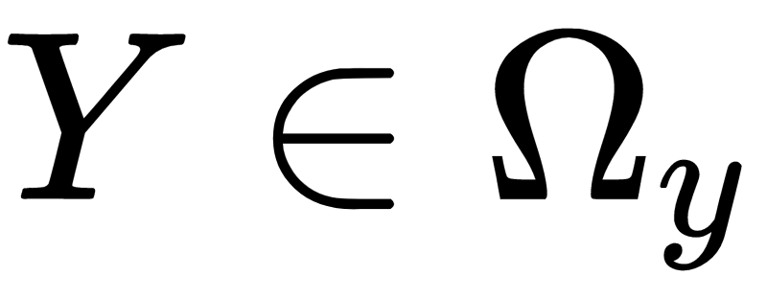
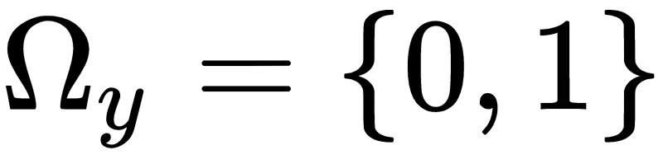
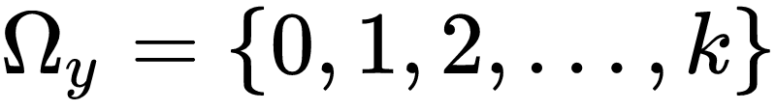
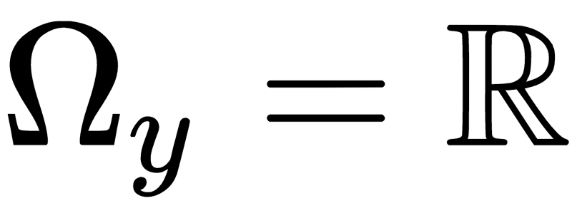
Kinds of state spaces
States of an information source should vary…
Binary Classification
Multiclass
Real Valued

Slide 24
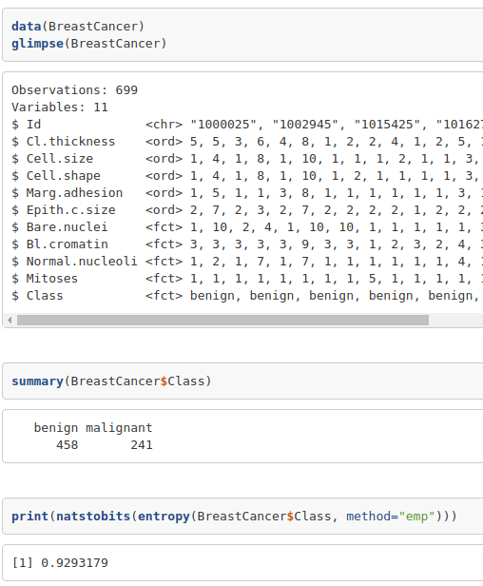
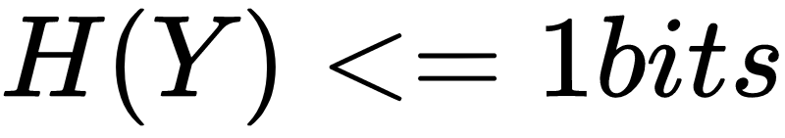
Binary Classification
Two Mutually Exclusive Outcomes
Entropy of
Coin Flips
Double-Headed Coin (P=1)
Fair Coin (P=0.5)
Unfair Coin (P=0.8)
UC Irvine Machine Learning Repository
U.S. Census Adult Data Set
Income > 50k a year, < 50k a year
Breast Cancer Wisconsin (Diagnostic) Data Set
Diagnosis (M = malignant, B = benign)
IMDB Reviews
Positive Review, Negative Review

Slide 25
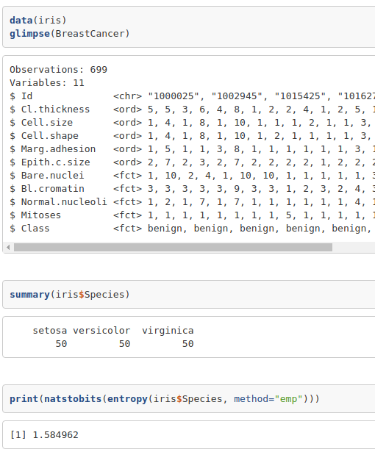

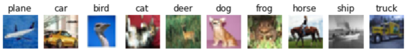
Multiclass Classification
UC Irvine Machine Learning Repository
Iris Data Set
Flower type: Setosa, Versicolour, Virginica
Wine Data Set
Wine 1, Wine 2, Wine 3
Car Evaluation Data Set
Condition Unacceptable, Acceptable, Good, Very Good
Twenty Newsgroups Data Set
20 Different Topics
MNIST
CIFAR-10
COCO
Streetview

Slide 26
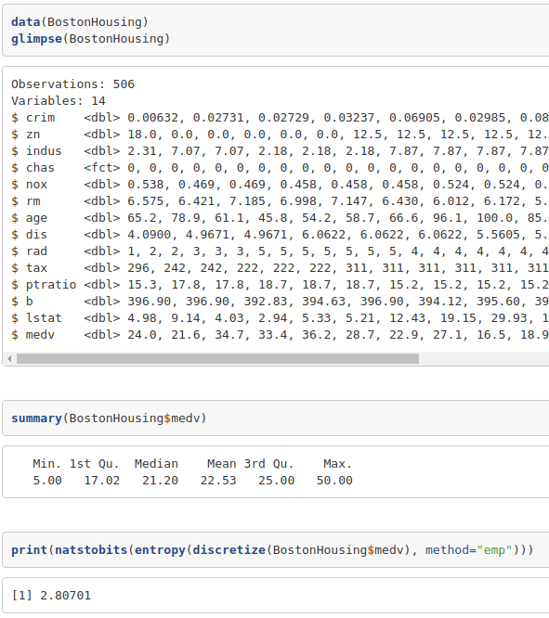
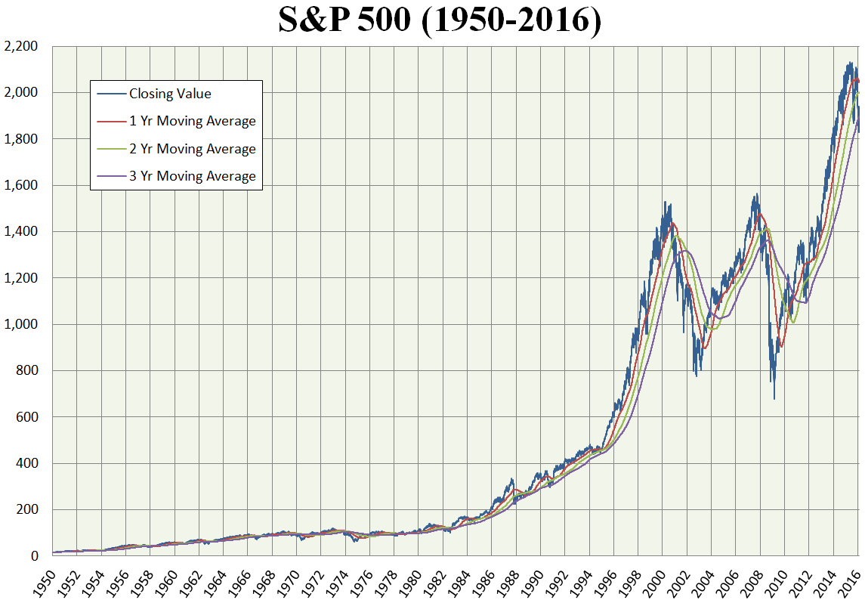
Real Valued
UCI Machine Learning Repository
Forest Fires Dataset
Burned area of the forest (hectares)
Automobile Data Set
Car Price ($1)
Boston Housing Data
Median Home Price ($1000)

Slide 27
What is a prediction?
A belief, at the destination, about the true state of the information source
Can come from anywhere and for any reason
Fit a model
Ask an expert
Flip a coin
Always pick ‘tails’
Can be degenerate
Always predict ‘Pizza’ for a coin flip

Slide 28
Comparing and
There are many different scoring methods you can use
They vary in
What kinds of errors they care most about
Whether they take into account chance
How they treat balanced versus imbalanced data
We’re going to review 5 scoring methods for binary predictions
Confusion matrix
Accuracy
Precision
Recall
F-1

Slide 29
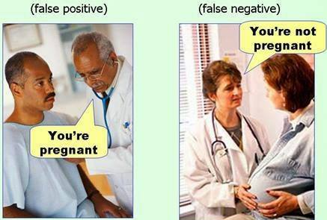
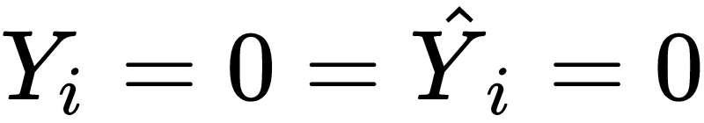




Scoring Binary Classification Rates
For any observation i, there are 4 possible combinations
True Negative
True Positive
False Positive
False Negative

Slide 30

Confusion Matrix
Compare Breast Cancer outcome to itself and three kinds of coin flips
Confusion Matrix
True state on the Y axis
Predicted state on the X axis
Diagonal is correct predictions
Off diagonal are incorrect predictions

Slide 31


Accuracy
Accuracy - the percentage of correct predictions
Pros
Easy to understand, just like a score on a test
Bounded and monotonic 0.0 - 1.0
Weights all four types of errors equally (good for balanced data)
Cons
Bad for unbalanced data. A receiver that just predicted 0 no matter what message was sent could have high accuracy if Y contained few 1s.

Slide 32


Precision
Precision - the percentage of correctly predicted positives as a fraction of predicted positives
If you see a positive prediction, how often is to be correct?
Uses
Needle in a haystack - find the few positive cases among a sea of negative ones
Pros
Bounded and monotonic 0.0 - 1.0
Penalizes over-guessing positives

Slide 33


Recall
Recall - Percentage of positive cases correctly predicted
Of the positives how many did we get right?
Uses
Questioning all the relevant suspects - If there’s a prison break, you don’t care how many pedestrians you stop and question around the prison, just that all of the inmates are found and questioned
Pros
Bounded and monotonic 0.0 - 1.0
Penalizes missing positives

Slide 34


Combining Precision and Recall - F1 Score
Scored 0 to 1, higher is better
Also Known As
Dice Similarity (Sørensen–Dice coefficient)
Harmonic mean of precision and recall
Uses
Search engines - Return all the relevant documents from a sea of irrelevant ones but no more than needed

Slide 35
Compare Scores
 | Accuracy | Precision | Recall | F1
 | 1.0 | 1.0 | 1.0 | 1.0
Fair Coin | 0.49 | 0.33 | 0.50 | 0.55
Unfair Coin | 0.41 | 0.34 | 0.80 | 0.31
Head/Head Coin | 0.34 | 0.34 | 1.0 | 0.51
Takeaways
Correct predictions do not imply learning
Random chance predictions can do quite well
Strong performance on one score does not guarantee strong performance on another
No universal definition of a ‘good’ prediction. Depends on the context and what kinds of errors are most important.

Slide 36

Probabilistic Predictions
We’re free to make as many predictions and kinds of predictions as we want
In addition to we can generate a vector or probabilities
Don’t have to be genuine probabilities
We can likewise score those predictions in clever ways (“proper scoring rules”)
reward being confident in correct guesses
penalize confidence in incorrect guesses
We’re going to review
logLoss
Area Under the AUC Curve
Area Under the Precision Recall Curve

Slide 37



LogLoss
Smaller is better
Penalizes high confidence in incorrect predictions
Increasingly steep the more confident
Has nice mathematical properties
Often can be optimized directly, e.g. the default loss function for XGBoost

Slide 38


Area Under the ROC Curve
Plots true positive rate against false positive rate
Example Curves
Top Left Corner - Perfect precision and recall, area under the curve of 1
45 degree line, random guessing
Prefer one classifier that strictly dominates another
Difficult when lines cross

Slide 39


Area Under the Precision-Recall Curve
Plots true positive rate against false positive rate
Better for imbalanced data
Example Curves
Top Right Corner - Perfect Precision and Recall, area under the curve of 1
90 degree line, random guessing
Prefer one classifier that strictly dominates another
Difficult when lines cross

Slide 40

Score Robustness to Class Imbalance
Skew= Number of Negative Examples / Number of Positive Examples
Vary the class balance of the dataset on the X axis
Hold the classifier constant
Show the score on each metric change just by changing the distribution of the data and nothing else
Takeaways
Avoid Kappa and Alpha for imbalanced data
Be careful about what is a positive for F1 and AUC PR
AUC ROC is a good compromise
1 is Perfectly Balanced
< 1 is more positives than negatives
> 1 is more negatives than positives

Slide 41

Comparing and for real valued
Absolute error
Weights all errors equally
Squared error
Increasingly severe penalties the further away the predictions from the truth
Huber
More forgiving for extreme errors than MSE and can tune with a parameter
Good for outliers and other noise (“robust regression”)

Slide 42
Predictions Takeaway
Machine learning begins and ends with defining what constitutes a ‘good’ prediction
Pick a scoring method tailored to your real world application
Consider more than one scoring method
Always consider placebo baseline predictions, e.g. all tails, 50/50 chance
Don’t throw away information, use probabilities if you can
Consider clance imbalance

Slide 43
How do we get from here to there?
We transmit a message
(SHANNON 1948)

Slide 44

Message
Messages are one or more symbols transmitted via a medium from an information source to a destination
A message X takes on a state from a set of possible states
Take a piece of paper and write anything on it and pass it to your neighbor
Messages don’t have to map to anything
Messages don’t have to conform to a particular length or language
Out of context, messages don’t convey information in themselves. Messages have to be ABOUT something

Slide 45
What is information?
Information is the the uncertainty at a destination of the state of the source that is reduced by a message

Slide 46
Example: A Zero Information Conversation
Student A - Flip a two headed (unfair) coin
Student B - Guess the outcome of the coin toss
Student A - Write down {‘H’,’T’} a note and pass it to the receiver
Student B - How surprised are you by the result? (That surprise is the information.)
Formally
Message Space S = {H,T}
X is a deterministic constant
Entropy (measure of surprise) defined as
No surprise, no information!

Slide 47
Example: A Zero Information Conversation (Takeaways)
Information is relative
It’s about something (the state of a source)
In terms of expectations of the receiver (what you didn’t already know about that state)
Not all messages are informative!
Deterministic sources produce no information.
If you know a clock is broken, you never have to look at it again.

Slide 48
0-bit source, 0-bit message
Y | X1 | X2 | ...
1 | 1 | 1 | ...
1 | 1 | 1 | ...
1 | 1 | 1 | ...
1 | 1 | 1 | ...
... | ... | ...
Non-varying information source
Two headed coin
No varying measurements
How many bits of information transmitted?

Slide 49
0-bit source, 1-bit message
Y | X1
1 | 0
1 | 1
1 | 1
1 | 1
... | ...
Non-varying information source
Two headed coin
One varying measurement
How many bits of information transmitted?

Slide 50
0-bit source, N bit message
Y | X1 | X2 | ...
1 | 0 | 1 | ...
1 | 1 | 1 | ...
1 | 0 | 1 | ...
1 | 1 | 0 | ...
... | ... | ...
Non-varying information source
Arbitrarily many varying measurements
How many bits of information transmitted?

Slide 51
1-bit source, 0-bit message
Y | X1
1 | 1
0 | 1
1 | 1
0 | 1
... | ...
1-bit (two states) varying information source
Two sided coin
Only incidents of both war and peace
One nonvarying measurement
How many bits of information transmitted?

Slide 52
1-bit source, 1-bit message
Y | X1
1 | 0
0 | 1
1 | 0
0 | 1
... | ...
1-bit (two states) varying information source
Two sided coin
Only incidents of both war and peace
One nonvarying measurement
How many bits of information transmitted?

Slide 53

Example: A One Bit Conversation
Student A - Flip a fair coin
Student B - Guess the outcome of the coin toss
Student A - Write down {‘H’,’T’} for tails on a note and pass it to the receiver
Student B - How surprised are you by the result?
Formally
Message Space S = {Head,Tails}, transmitter f(“Heads)=”Tails”, f(“Tails”)=”Heads”
Y is a random variable

Slide 54
Example: A One Bit Conversation (Takeaways)
Meaning of symbols in a message is contextual not fixed
A transmitter that always messages the true state of the coin is exactly as useful as one that always messages the opposite of the true state. Same amount of information, the specific symbol is irrelevant.
Communication channel doesn’t matter as long as it has enough bandwidth
Note, text, phone call, temperature sensor, whisper, are equivalent

Slide 55
Outline for After the Break
 |  |  | Information Source
 |  | 0-Bits | 1-Bit | 2-Bits | N-Bits
 | 0-Bits | No Conversation | Accuracy Measures
Message | 1-Bits | No Information Conversation Selecting on the Dependent Variable | Risk Analysis/No Free Lunch Overfitting Training/Test/Cross Validation | Overdetermination
 | 2-Bits | Long No Information Conversations | Feature Selection Feature Engineering Model Complexity
 | N-Bits | Very Long No Information Conversations | Confounding Curse of Dimensionality
 |  |  | Mutual Information Accuracy, Precision, Recall,... Area Under the Curve | Cross Entropy

